Slide 1
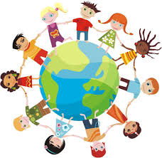

™
Massage in Schools Programme
MISP
The vision of the Massage in Schools Programme is that every child attending school experiences positive and nurturing touch every day, everywhere in the world.

Slide 2
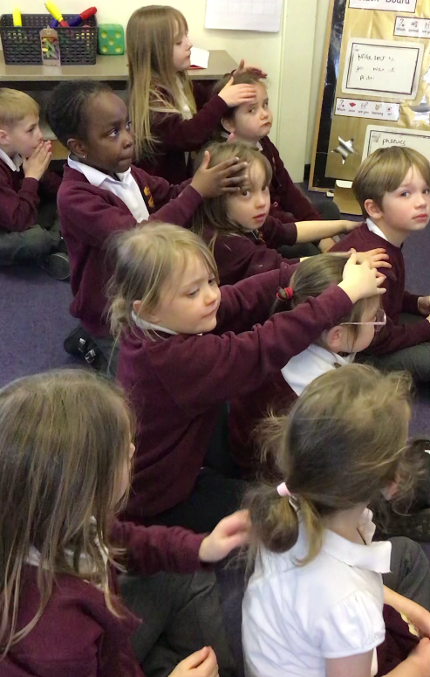

Characteristics of the MISP:
World-wide recognised professional programme
Positive touch for children
A fully clothed approach
Child to child massage routine
Entire routine takes less than 15 mins

Slide 3
Why do we need the MISP?
Neuroscientific studies show that humans beings need touch. The skin is our bodies largest sensory organ and is directly connected to our nervous system. Without touch, human beings cannot survive or develop in a healthy way, physically, socially or emotionally.
Official studies carried out on massage itself state, among other things, that massage helps to strengthen the immune system, lower stress levels, and increase the production of relaxing hormones. Feedback from parents, teachers and children from schools practising the programme report numerous positive effects on the children including:
*Calmer, reduction in stress levels
*Better sleep
*Improved self esteem
*Building respect and trust for others
*Develops gratitude
*Building relationships with others and reduces isolation
*Ready to listen and learn
*Understanding of how to self calm
*Less aggressive
*Builds a sense of belonging
*Improved concentration
*Equality
*Understanding of appropriate touch and consent
*Understanding differences between themselves and others
*An activity all can be involved in which is not target orientated
In enabling children to have regular positive touch experiences they will hopefully be able to bring the positive effects of nurturing touch into adulthood.

Slide 4
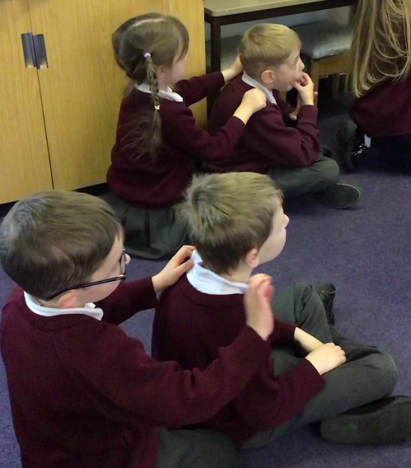
At Milford Infants’ School Peer Massage takes place in classes at least three times a week.
The children follow a 15 stroke routine which has been developed by physiotherapist and is
based on therapeutic
massage strokes.

Slide 5
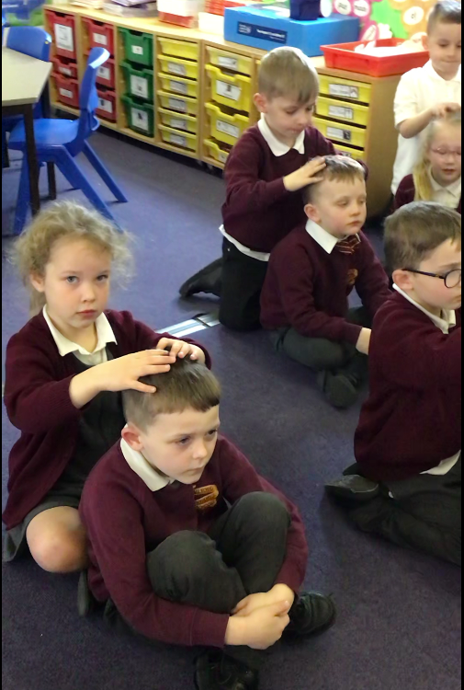
Some children are more sensitive to touch than others.
For this reason, the teacher models what the children are going to be expected to do so they can make an informed decision as to whether or not to take part.
The children are given opportunities
to tell their partner how they would
like their massage firm or soft.

Slide 6
Quotes from children at Milford Infants’ after taking part in Peer Massage
“Massage makes me
feel special”
“I love doing the
massage because it
makes me have
more friends”
“It makes me feel all calm and relaxed”
“It makes me calm nown after a busy playtime!
“It’s so relaxing”
“Alfie gave me the best massage, I feel a bit sleepy now!”

Slide 7
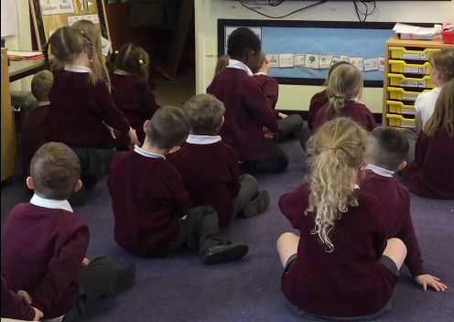
Quotes from Teachers
“The first thing I noticed when children came into my classroom and already knew the
massage is that they were respectful
to their classmates and to me”
“I’ve noticed changes in how the children show
consideration, and share and resolve conflicts,
it certainly helps them build new relationships.
“After the afternoon massage,
the children are in a really good place. It works well to calm them after lunch and helps them be ready to listen and learn.

Slide 8
The teachers explains to the children that we will be using our hands and carry out ‘Massage Strokes’ on a partner. Our hands will be on top of their clothes. The massage will be relaxing. It will help us feel calm. The massage will help us to feel happy and help us to concentrate.
*The children can be given, or choose partners.
*The child giving the massage will sit behind their partner. They will turn to their partner and ask ‘can I give you a massage’. At this point the child can choose to accept, or politely decline (in which case they can sit and watch)
*The children follow the 15 stroke sequence as modelled by their class teacher.
*The children who have received the massage turn to their partner and say ‘thank you’.
*The class are then asked to swap with their partner; so the child who has received a massage then carries it out on their partner.

Slide 9
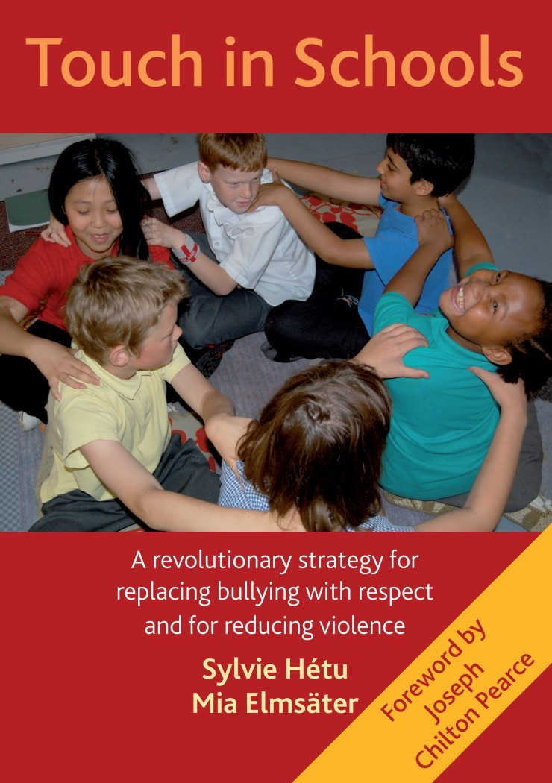
For more Information:
www.massageinschools.com

Slide 10

www.misa.org.uk

